Slide 1

Chapter 10
Exceptions

Slide 2
Chapter Scope
The purpose of exceptions
Exception messages
The call stack trace
The try-catch statement
Exception propagation
The exception class hierarchy
I/O exceptions (and writing text files)

Slide 3
Exceptions
An exception is an object that describes an unusual or erroneous situation
Exceptions are thrown by a program, and may be caught and handled by another part of the program
A program can be separated into a normal execution flow and an exception execution flow
An error is also represented as an object in Java, but usually represents a unrecoverable situation and should not be caught

Slide 4
Exception Handling
The Java API has a predefined set of exceptions and errors that can occur during execution
A program can deal with an exception in one of three ways:
ignore it
handle it where it occurs
handle it an another place in the program
The manner in which an exception is processed is an important design consideration

Slide 5
Uncaught Exceptions
If an exception is ignored by the program, the program will terminate abnormally and produce an appropriate message
The message includes a call stack trace that
indicates the line on which the exception occurred
shows the method call trail that lead to the attempted execution of the offending line

Slide 6
//********************************************************************
// Zero.java Java Foundations
//
// Demonstrates an uncaught exception.
//********************************************************************
public class Zero
{
//-----------------------------------------------------------------
// Deliberately divides by zero to produce an exception.
//-----------------------------------------------------------------
public static void main(String[] args)
{
int numerator = 10;
int denominator = 0;
System.out.println("Before the attempt to divide by zero.");
System.out.println(numerator / denominator);
System.out.println("This text will not be printed.");
}
}

Slide 7
The try-catch Statement
To handle an exception in a program, the line that throws the exception is executed within a try block
A try block is followed by one or more catch clauses
Each catch clause has an associated exception type and is called an exception handler
When an exception occurs, processing continues at the first catch clause that matches the exception type

Slide 8
//********************************************************************
// ProductCodes.java Java Foundations
//
// Demonstrates the use of a try-catch block.
//********************************************************************
import java.util.Scanner;
public class ProductCodes
{
//-----------------------------------------------------------------
// Counts the number of product codes that are entered with a
// zone of R and and district greater than 2000.
//-----------------------------------------------------------------
public static void main(String[] args)
{
String code;
char zone;
int district, valid = 0, banned = 0;
Scanner scan = new Scanner(System.in);
System.out.print("Enter product code (STOP to quit): ");
code = scan.nextLine();

Slide 9
while (!code.equals("STOP"))
{
try
{
zone = code.charAt(9);
district = Integer.parseInt(code.substring(3, 7));
valid++;
if (zone == 'R' && district > 2000)
banned++;
}
catch (StringIndexOutOfBoundsException exception)
{
System.out.println("Improper code length: " + code);
}
catch (NumberFormatException exception)
{
System.out.println("District is not numeric: " + code);
}
System.out.print("Enter product code (STOP to quit): ");
code = scan.nextLine();
}
System.out.println("# of valid codes entered: " + valid);
System.out.println("# of banned codes entered: " + banned);
}
}

Slide 10
The finally Clause
A try statement can have an optional clause following the catch clauses, designated by the reserved word finally
The statements in the finally clause always are executed
If no exception is generated, the statements in the finally clause are executed after the statements in the try block complete
If an exception is generated, the statements in the finally clause are executed after the statements in the appropriate catch clause complete

Slide 11
Exception Propagation
An exception can be handled at a higher level if it is not appropriate to handle it where it occurs
Exceptions propagate up through the method calling hierarchy until they are caught and handled or until they reach the level of the main method
A try block that contains a call to a method in which an exception is thrown can be used to catch that exception

Slide 12
//********************************************************************
// Propagation.java Java Foundations
//
// Demonstrates exception propagation.
//********************************************************************
public class Propagation
{
//-----------------------------------------------------------------
// Invokes the level1 method to begin the exception demonstration.
//-----------------------------------------------------------------
static public void main(String[] args)
{
ExceptionScope demo = new ExceptionScope();
System.out.println("Program beginning.");
demo.level1();
System.out.println("Program ending.");
}
}

Slide 13
//********************************************************************
// ExceptionScope.java Java Foundations
//
// Demonstrates exception propagation.
//********************************************************************
public class ExceptionScope
{
//-----------------------------------------------------------------
// Catches and handles the exception that is thrown in level3.
//-----------------------------------------------------------------
public void level1()
{
System.out.println("Level 1 beginning.");
try
{
level2();
}
catch (ArithmeticException problem)
{
System.out.println();
System.out.println("The exception message is: " +
problem.getMessage());
System.out.println();
System.out.println("The call stack trace:");
problem.printStackTrace();
System.out.println();
}
System.out.println("Level 1 ending.");
}

Slide 14
//-----------------------------------------------------------------
// Serves as an intermediate level. The exception propagates
// through this method back to level1.
//-----------------------------------------------------------------
public void level2()
{
System.out.println("Level 2 beginning.");
level3();
System.out.println("Level 2 ending.");
}
//-----------------------------------------------------------------
// Performs a calculation to produce an exception. It is not
// caught and handled at this level.
//-----------------------------------------------------------------
public void level3()
{
int numerator = 10, denominator = 0;
System.out.println("Level 3 beginning.");
int result = numerator / denominator;
System.out.println("Level 3 ending.");
}
}

Slide 15
The Exception Class Hierarchy
Classes that define exceptions are related by inheritance, forming an exception class hierarchy
All error and exception classes are descendents of the Throwable class
A programmer can define an exception by extending the Exception class or one of its descendants
The parent class used depends on how the new exception will be used

Slide 16
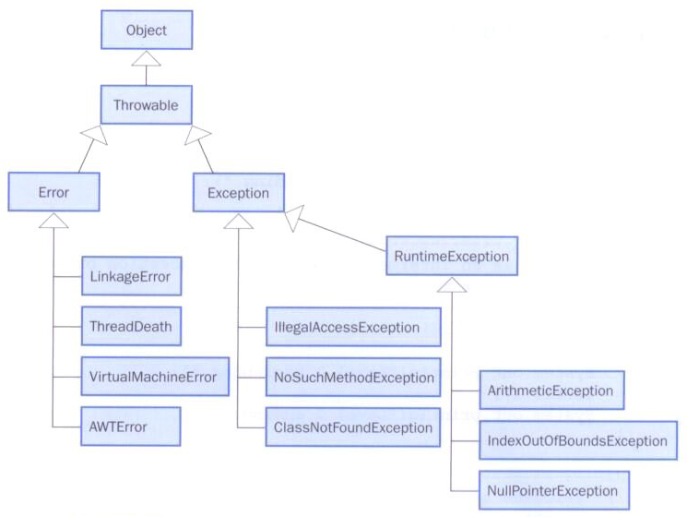
The Exception Class Hierarchy
Part of the error and exception class hierarchy in the Java API:

Slide 17
Checked Exceptions
An exception is either checked or unchecked
A checked exception either must be caught by a method, or must be listed in the throws clause of any method that may throw or propagate it
A throws clause is appended to the method header
The compiler will issue an error if a checked exception is not caught or asserted in a throws clause

Slide 18
Unchecked Exceptions
An unchecked exception does not require explicit handling, though it could be processed that way
The only unchecked exceptions in Java are objects of type RuntimeException or any of its descendants
Errors are similar to RuntimeException and its descendants in that:
Errors should not be caught
Errors do not require a throws clause

Slide 19
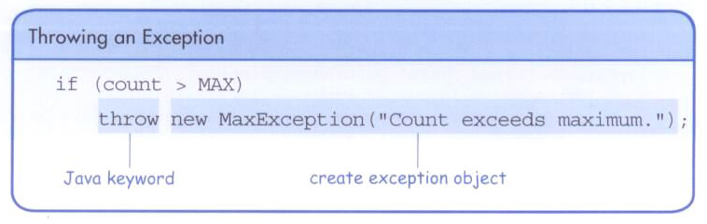
The throw Statement
Exceptions are thrown using the throw statement
Usually a throw statement is executed inside an if statement that evaluates a condition to see if the exception should be thrown

Slide 20
//********************************************************************
// CreatingExceptions.java Java Foundations
//
// Demonstrates the ability to define an exception via inheritance.
//********************************************************************
import java.util.Scanner;
public class CreatingExceptions
{
//-----------------------------------------------------------------
// Creates an exception object and possibly throws it.
//-----------------------------------------------------------------
public static void main(String[] args) throws OutOfRangeException
{
final int MIN = 25, MAX = 40;
Scanner scan = new Scanner(System.in);
OutOfRangeException problem =
new OutOfRangeException("Input value is out of range.");
System.out.print("Enter an integer value between " + MIN +
" and " + MAX + ", inclusive: ");
int value = scan.nextInt();
// Determine if the exception should be thrown
if (value < MIN || value > MAX)
throw problem;
System.out.println("End of main method."); // may never reach
}
}

Slide 21
//********************************************************************
// OutOfRangeException.java Java Foundations
//
// Represents an exceptional condition in which a value is out of
// some particular range.
//********************************************************************
public class OutOfRangeException extends Exception
{
//-----------------------------------------------------------------
// Sets up the exception object with a particular message.
//-----------------------------------------------------------------
OutOfRangeException(String message)
{
super(message);
}
}

Slide 22
I/O Exceptions
Let's examine issues related to exceptions and I/O
A stream is a sequence of bytes that flow from a source to a destination
In a program, we read information from an input stream and write information to an output stream
A program can manage multiple streams simultaneously

Slide 23
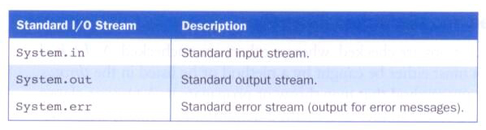
Standard I/O
There are three standard I/O streams:
We use System.out when we execute println statements
System.out and System.err typically represent a particular window on the monitor screen
System.in typically represents keyboard input, which we've used with Scanner objects

Slide 24
The IOException Class
Operations performed by some I/O classes may throw an IOException
A file might not exist
Even if the file exists, a program may not be able to find it
The file might not contain the kind of data we expect
An IOException is a checked exception

Slide 25
Writing Text Files
In Chapter 4 we explored the use of the Scanner class to read input from a text file
Let's now examine other classes that let us write data to a text file
The FileWriter class represents a text output file, but with minimal support for manipulating data
Therefore, we also rely on PrintWriter objects, which have print and println methods

Slide 26
Writing Text Files
We build the class that represents the output file by combining these classes appropriately
Output streams should be closed explicitly
Let's look at a program that writes a test data file with random 2-digit numbers

Slide 27
//********************************************************************
// TestData.java Java Foundations
//
// Demonstrates I/O exceptions and the use of a character file
// output stream.
//********************************************************************
import java.util.Random;
import java.io.*;
public class TestData
{
//-----------------------------------------------------------------
// Creates a file of test data that consists of ten lines each
// containing ten integer values in the range 10 to 99.
//-----------------------------------------------------------------
public static void main(String[] args) throws IOException
{
final int MAX = 10;
int value;
String file = "test.dat";
Random rand = new Random();
FileWriter fw = new FileWriter(file);
BufferedWriter bw = new BufferedWriter(fw);
PrintWriter outFile = new PrintWriter(bw);

Slide 28
for (int line=1; line <= MAX; line++)
{
for (int num=1; num <= MAX; num++)
{
value = rand.nextInt(90) + 10;
outFile.print(value + " ");
}
outFile.println();
}
outFile.close();
System.out.println("Output file has been created: " + file);
}
}

Slide 29
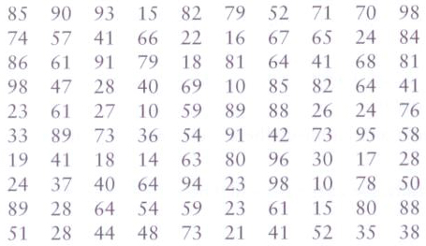
TestData Example
Sample data written to the file:

